Slide 1


Slide 2
Volleyball
Rules

Slide 3
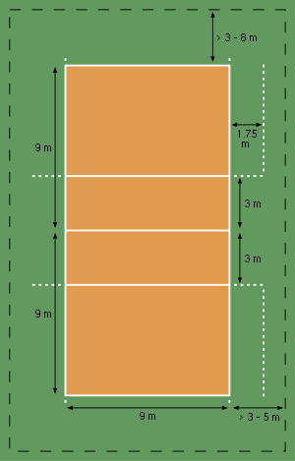
FIeld
Volleyball is played on a rectangular area of ​​18 x 9 meters.
It’s divided in two by a net and has a front zone of 3 metres wigth on each side of the net.
The height of the net is 2.43 meters for males and 2.24 meters for females.

Slide 4
BasIc rUles
To play, two teams of 6 players rally the ball each other over the net.
5-set matches are four sets to 25 points and a fifth set to 15. The team must win by 2 points. The first team to win three sets is the winner.
A team gets one point in two situations:
First way, when the ball hits the ground on the opponent's side of court.
Second way, when a team is unable to return the ball or commits a foul.

Slide 5
Each game begins with a serve hit with the hand
The team which receives the ball is entitled to three touches with the ball before sending it back. All parts of the body can be used. A single player does not have the right to touch the ball twice in a row
If the team which served wins the point they keep the same server
If the receiving team wins the point, it wins the serve and winner team players rotate clockwise

Slide 6
CEV Women's Champıons League
The Women's CEV Champions League, formerly known as CEV Champions Cup (from 1960 to 2000), is the top official competition for women's volleyball clubs of Europe and takes place every year. It is organized by the Confédération Européenne de Volleyball (CEV) and was created in 1960 as CEV Champions Cup.On 13 November 2000, it was officially presented in Florence under a new format and renamed CEV Champions League.

Slide 7
Famous voleyball players

Slide 8
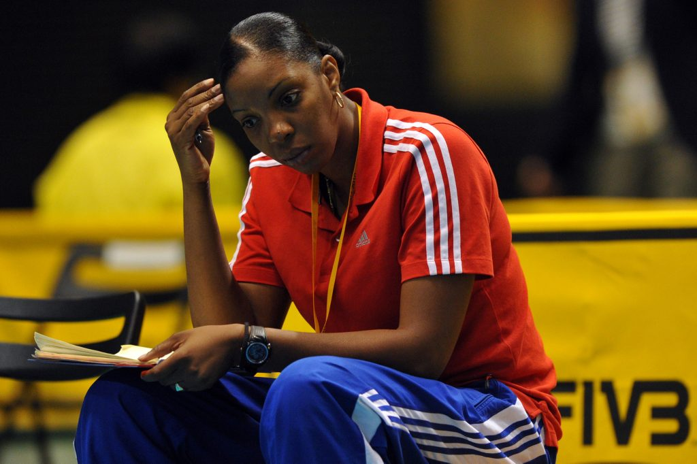
Regla Torres

Slide 9
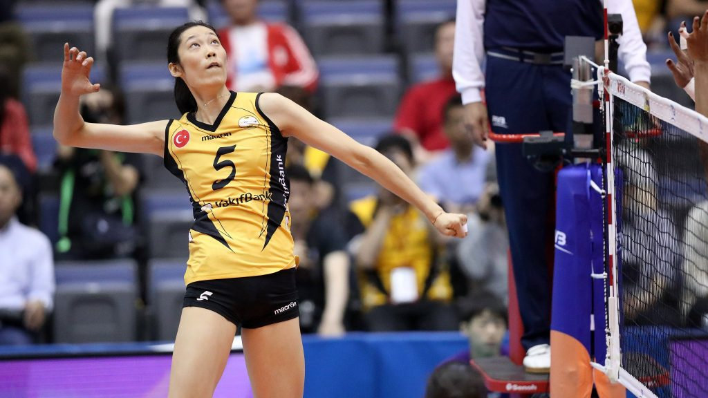
Ting Zhu

Slide 10

Jacqueline Carvalho

Slide 11

Francesca Piccinini

Slide 12
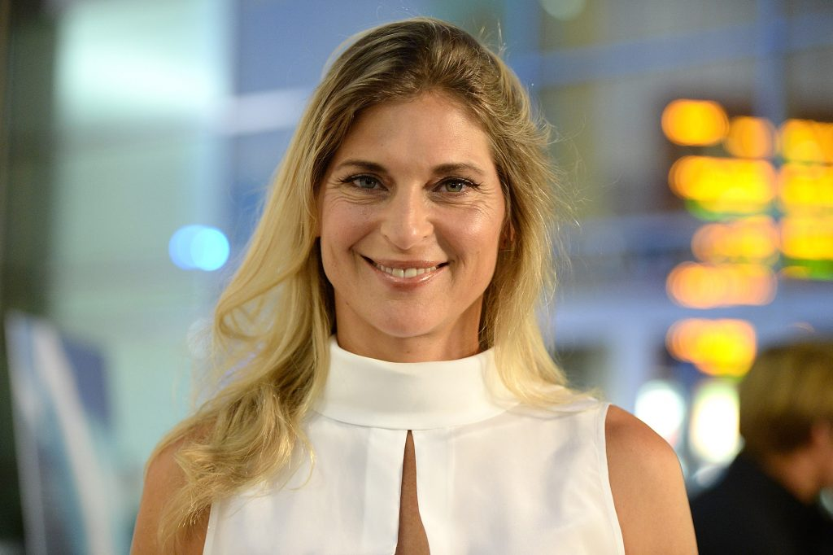
Gabrielle Reece

Slide 13
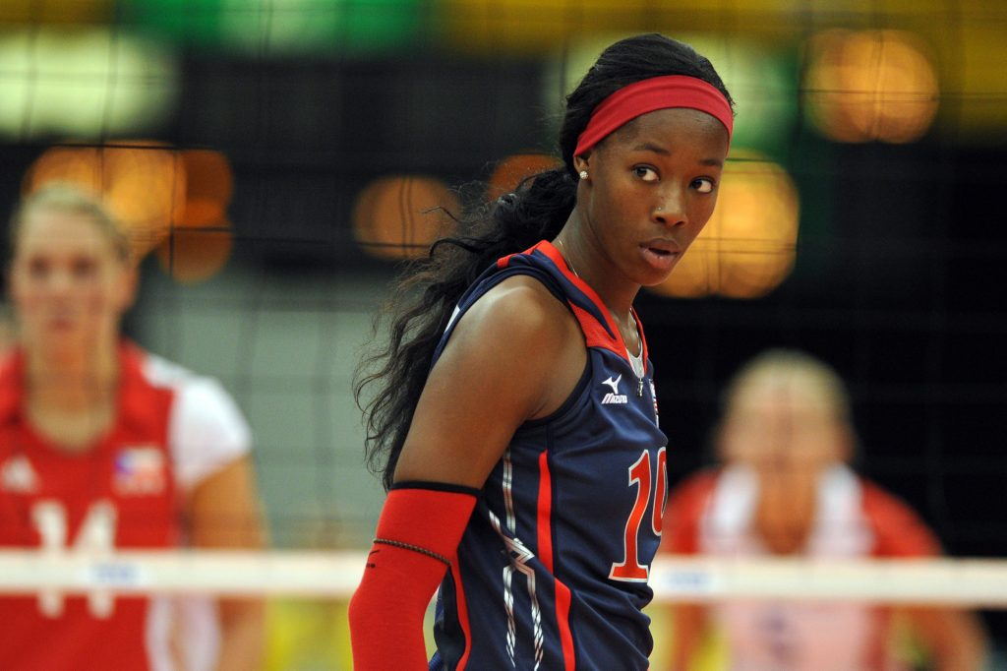
Destınee Hooker

Slide 14
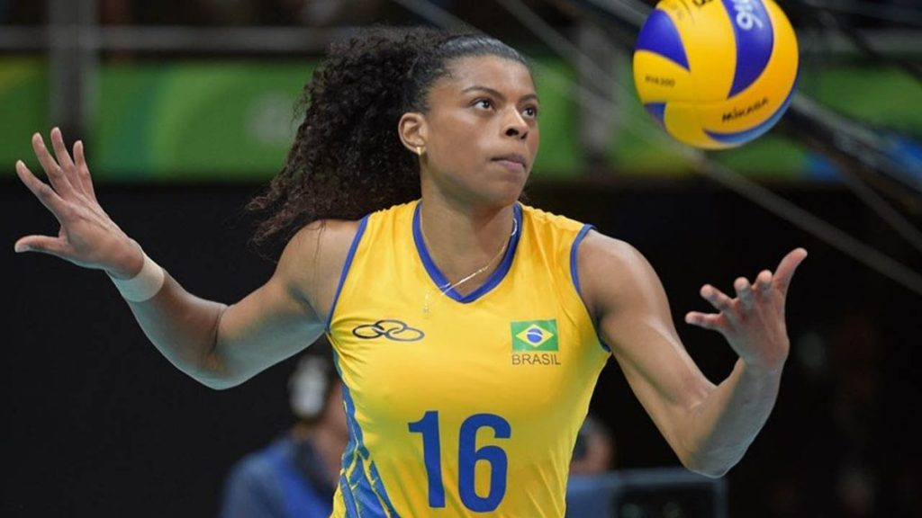
Fernanda Garay

Slide 15
Top 5 in National Teams
Woman

Slide 16
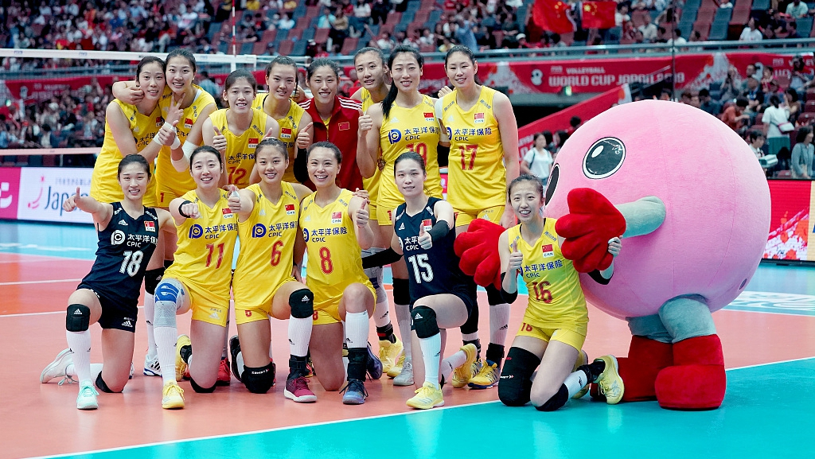
1.China women's national volleyball team

Slide 17
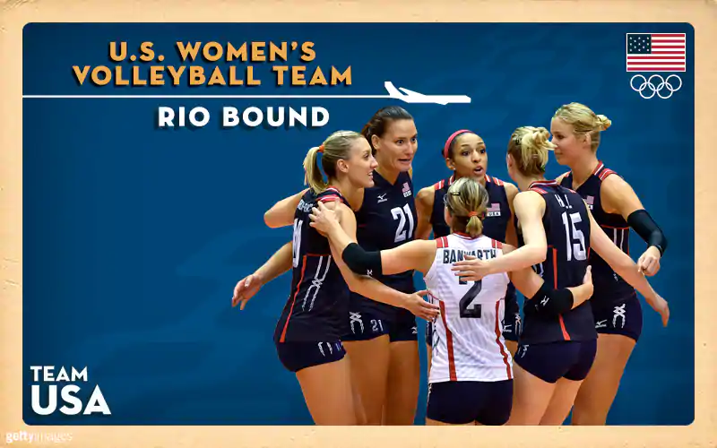
2.United States women's national volleyball team

Slide 18
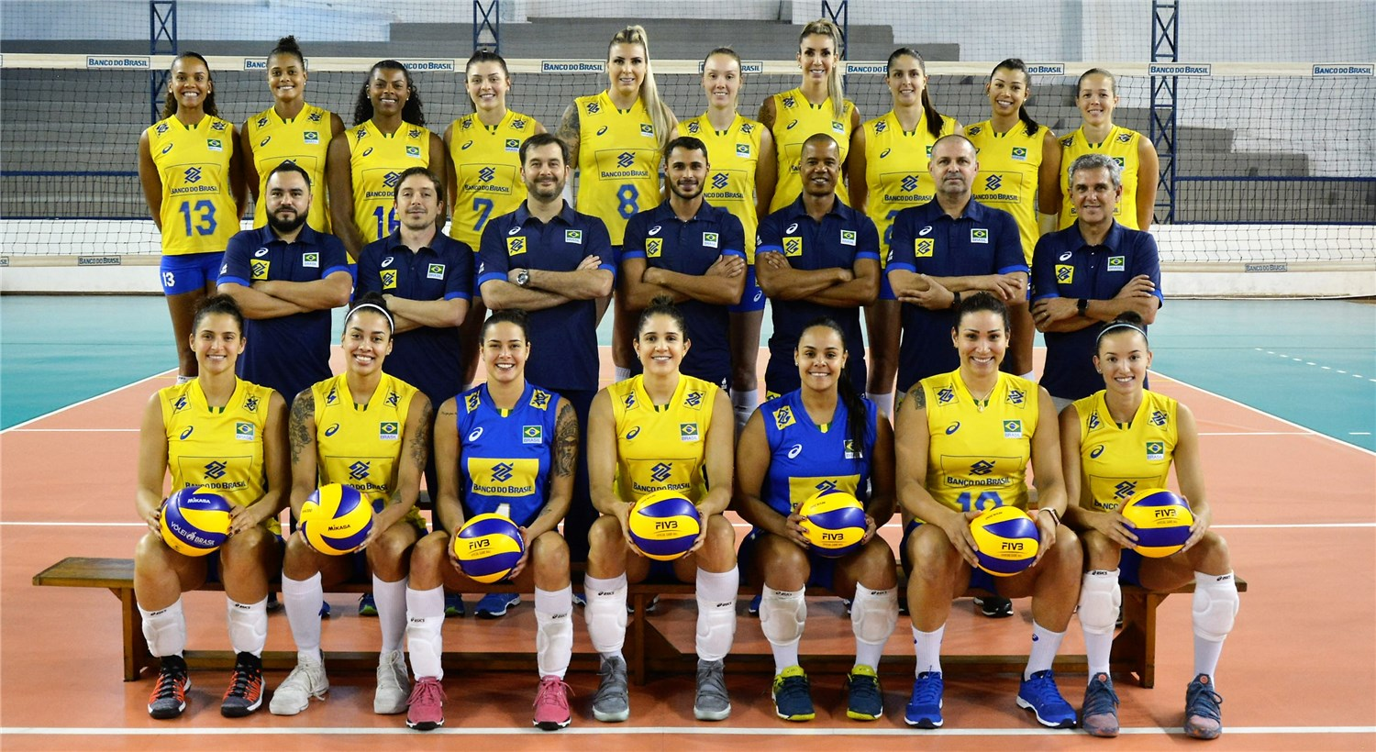
3.Brazil women's national volleyball team

Slide 19
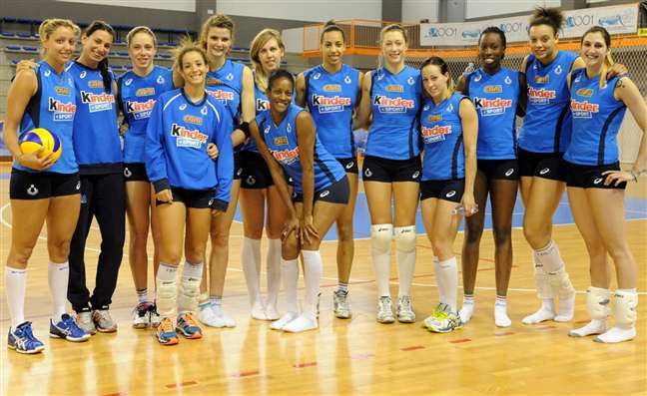
4.Italy women's national volleyball team

Slide 20
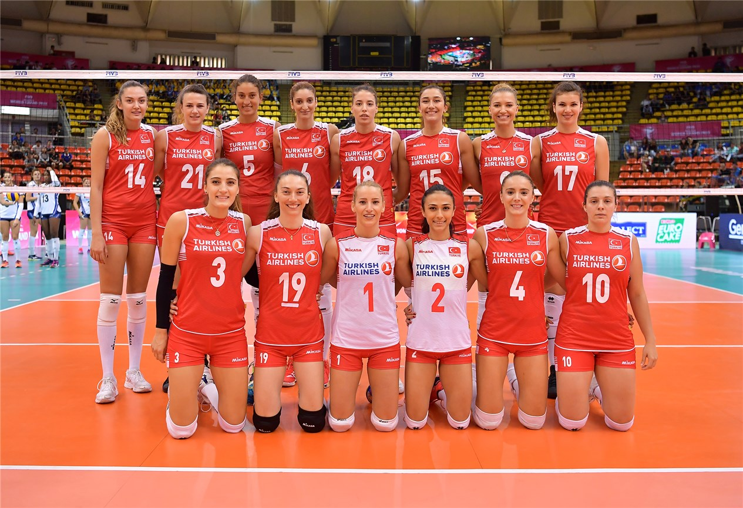
5.Turkey women's national volleyball team4

Slide 21
Top 5 in National Teams
men

Slide 22
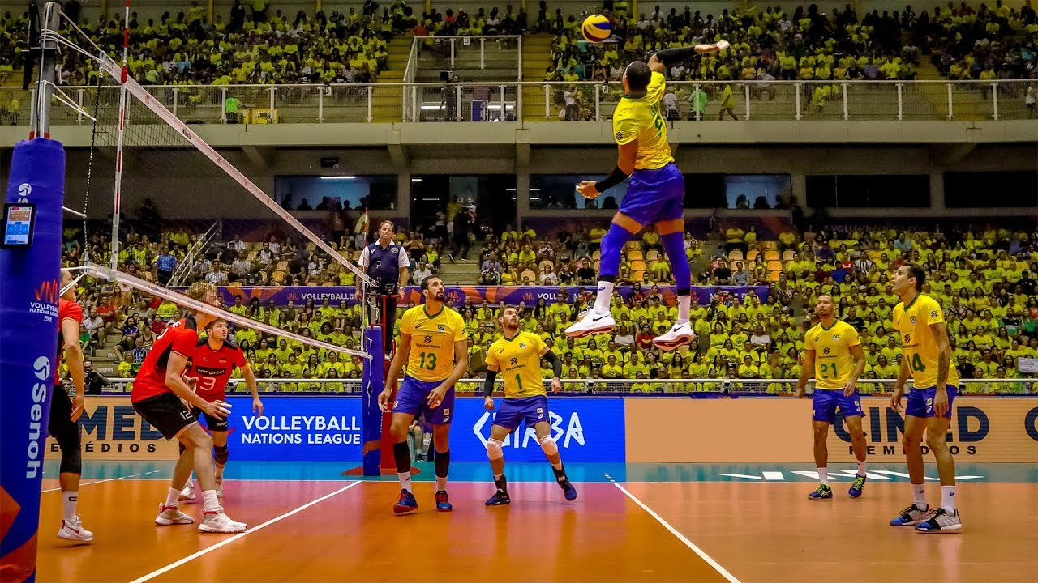
1.Brazil men's national volleyball team

Slide 23
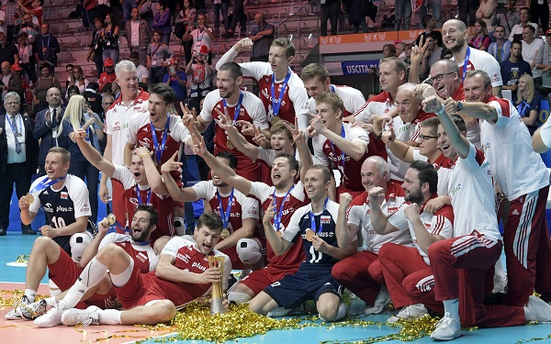
2.Poland men's national volleyball team

Slide 24
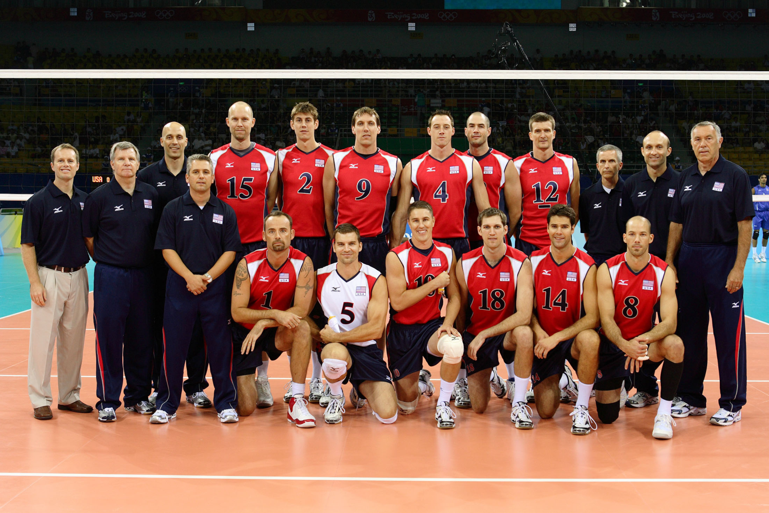
3.United States men's national volleyball team

Slide 25
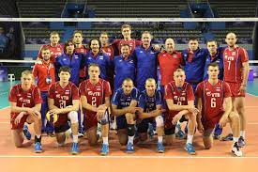
4.Russia men's national volleyball team

Slide 26
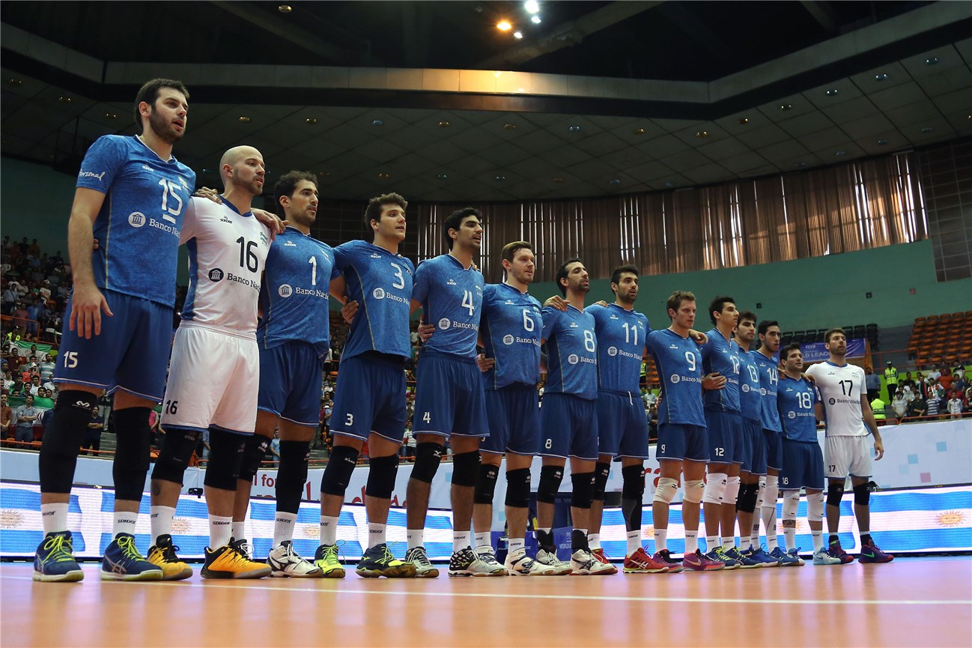
5.Argentina men's national volleyball team

Slide 27
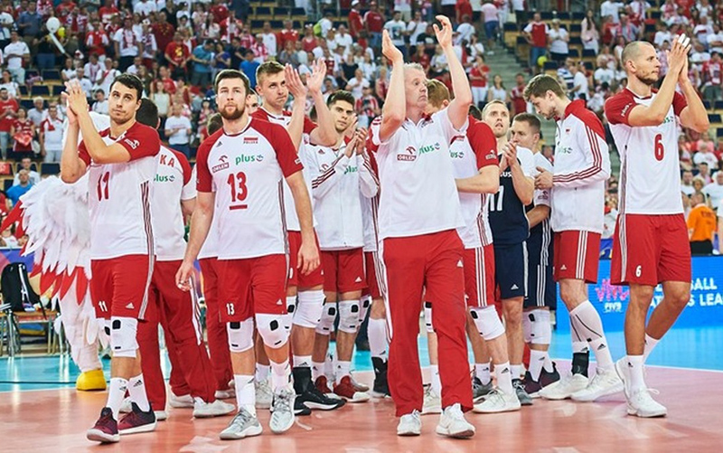
POLAND MEN’S NATIONAL VOLLEYBALL TEAM

Slide 28
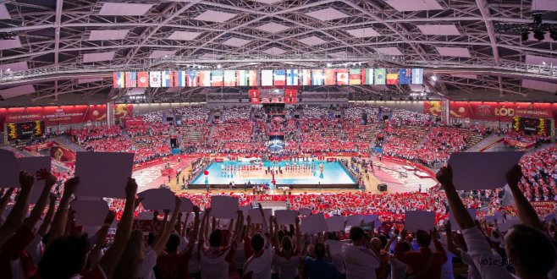
They broke a record with 60,000 spectators in the volleyball match in poland

Slide 29

sport is a branch of holding on to life

