Slide 1
Czech cuisine

Slide 2
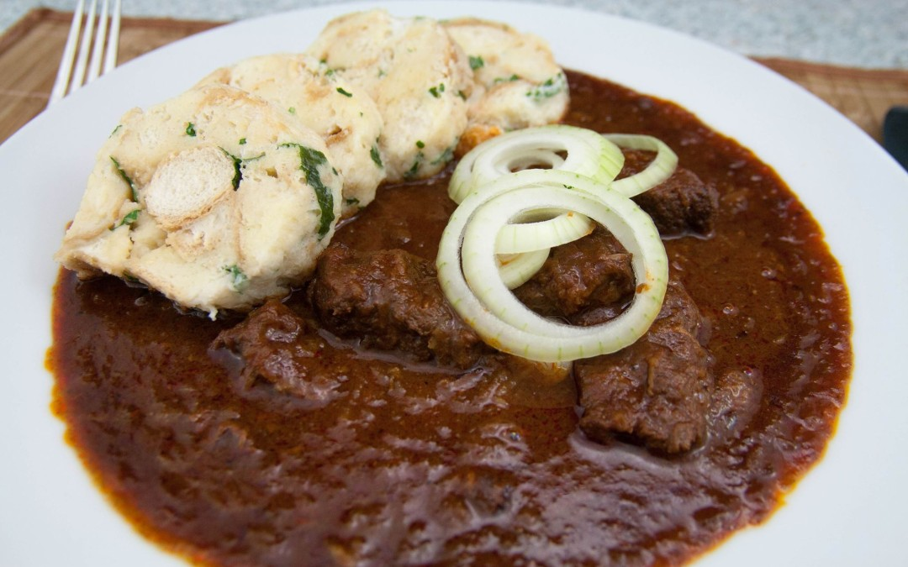
Goulash-guláš
The side dish is a dumpling.
Goulash consists of beef or pork.
The sauce is cooked from the meat and we add chili peppers and onions and a thickener.

Slide 3
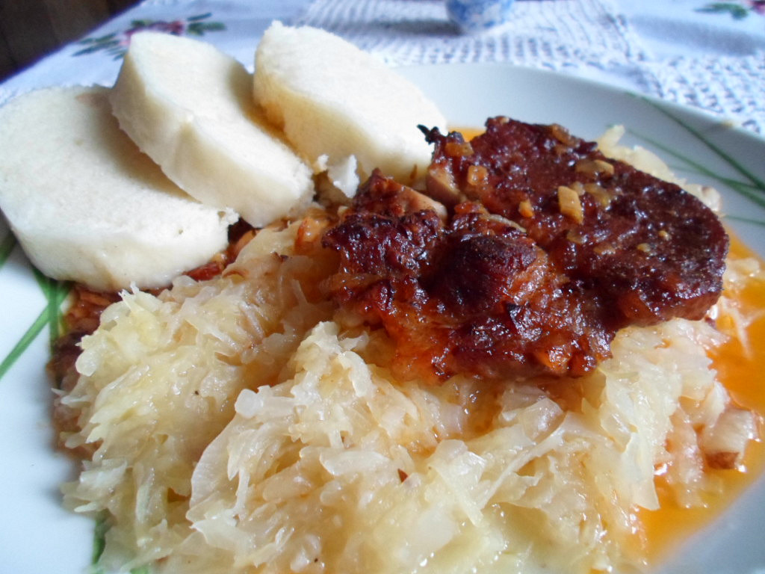
pork, dumplings and sauerkraut-vepřo knedlo zelo
The side dish is a dumpling.
Boiled sauerkraut.
Boiled pork.

Slide 4
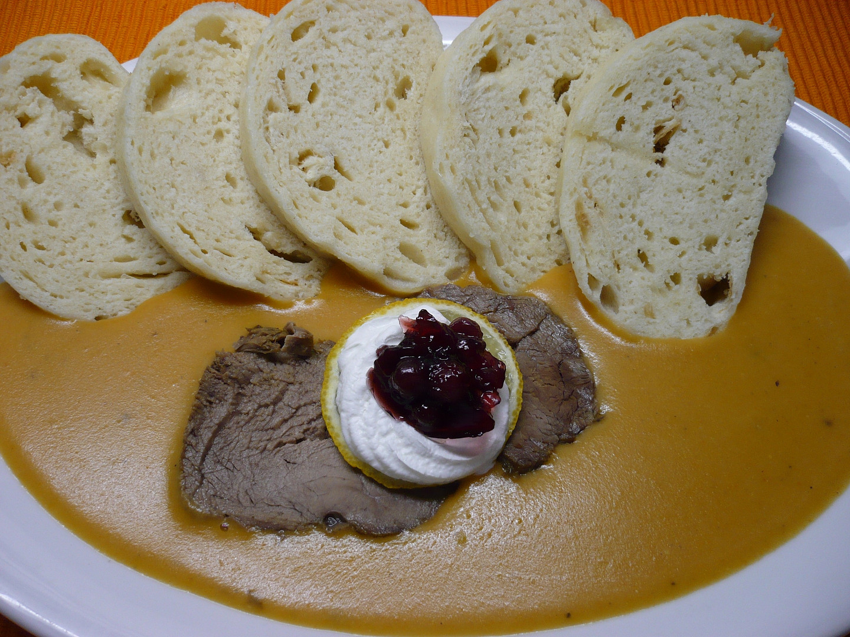
Sirloin with cream Sauce-svíčková
The side dish is a dumpling.
The dish consists of beef.
The sauce is made from stewed vegetables and cream.

Slide 5
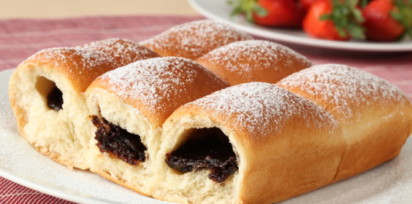
HonzA buns-honzovy buchty
The honza buns are filled with jam, quark or poppy.

Slide 6
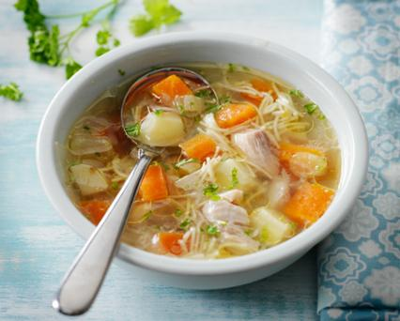
Beef Bouillon-vývar
The bouillon is from boiled meat with noodles and vegetables.

