Slide 1

Název školy: Střední průmyslová škola, Ostrava - Vítkovice, příspěvková organizace
Autor: Mgr. Pavlína Hůrková
Datum: 15. 8. 2012
Název: VY_22_INOVACE_1.1.31
Číslo projektu: CZ.1.07/1.5.00/34.0125
Sada: 1 Reálie
Téma: American Literature
Anotace: Tento materiál slouží k ilustraci výkladu učitele k probíranému tématu.
Cílová skupina – 3.,4. ročník.

Slide 2
AMERICAN LITERATURE
AMERICKÁ LITERATURA

Slide 3
Colonial and Revolutionary Literature
historical essays, religious prose and poetry, biographies, songs, ballads, political prose and poetry…….

Slide 4
19th Century Literature
romanticism in America was connected with nationalism, a new spiritual era
James Fenimore Cooper – Indian novels
Herman Melville (Moby Dick)
Walt Whitman (Leaves of Grass)
Edgar Allan Poe (The Raven, The Black Cat, The Pit and the Pendulum)

Slide 5
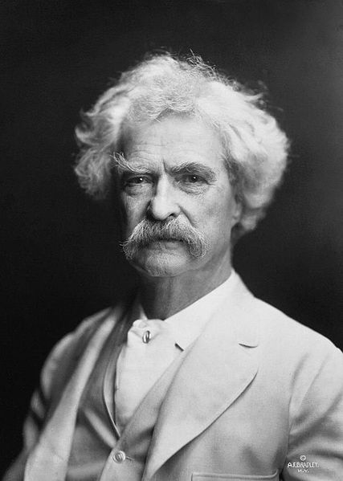
Mark Twain (1835 – 1910)

Slide 6
Mark Twain
one of the greatest US authors
he comes from the South
his real name – Samuel Langhorne
his best books are based on his own experience along the Mississippi
The Adventures of Tom Sawyer
The Adventures of Huckleberry Finn

Slide 7
20th Century Literature
after the World War I a group of writers – LOST GENERATION
writers were influenced by the war –disillusionment
Francis Scott Fitzgerald (The Great Gatsby) John Steinbeck (Of Mice and Men)
Sinclair Lewis (Main Street)
William Faulkner (Light in August)

Slide 8
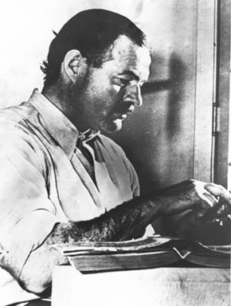
Ernest Hemingway (1898 – 1961)

Slide 9
Ernest Hemingway
he brought psychological realism together with symbolism
he was awarded the Nobel Prize in 1954
Fiesta or Sun Also Rises
For Whom the Bell Tolls
A Farewell to Army
The Old Man and the Sea

Slide 10
Other Authors of 20th Century
Jerome David Salinger (The Catcher in the Rye)
Norman Mailer (The Naked and Dead)
William Styron (Sophie‘s Choice)
Joseph Heller (Catch-22)

Slide 11
The Beat Generation
these writers focused on individualism as the supreme human goal and denounced the life of middle-class Americans as morally decadent
Allen Ginsberg
Lawrence Ferlinghetti
Jack Kerouac (On the Road)

Slide 12
Děkuji za pozornost.
Zpracovala Mgr. Pavlína Hůrková
Zdroje:
Belán, J.: Odmaturuj z anglického jazyka. Didaktis, 2005.
Matoušková, K., Faktorová, B.: Maturita. Fragment, 2007.

